Slide 1

A
PROJECT PRESENTATION
ON
OPTIMIZED VIDEO TEXT ANALYZER
SUBMITTED BY-
Umendra 1900270110059
Ishita 2000270119004
Shivam 1900270130159
Tushar 1900270110057
Under the Guidance of –
Dr Anupama Sharma
Associate Professor
AKGEC
DEPARTMENT OF INFORMATION TECHNOLOGY
AJAY KUMAR GARG ENGINEERING COLLEGE
27th KM MILESTONE, DELHI-HAPUR BYPASS ROAD
GHAZIABAD-201009

Slide 2
TABLE OF CONTENT
Introduction
AIM/Objective of Project
Scope
Feasibility of Project
Methodology
Requirement Analysis
Future Scope

Slide 3
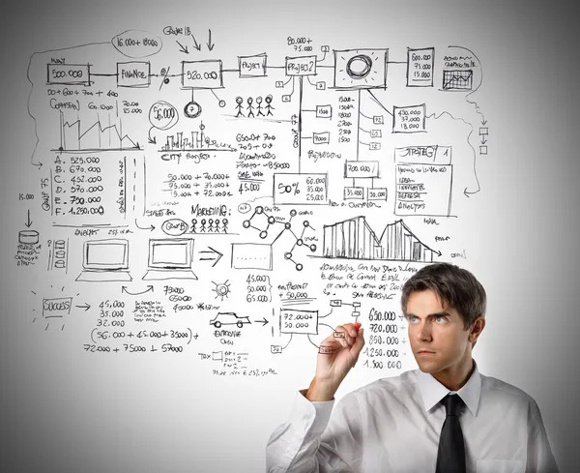
INTRODUCTION
As we know in this digital era no one has time to go through the long videos for only particular information.ibil
As it is very time consuming
And costly as well.

Slide 4
INTRODUCTION
Video text Analyzer will be helpful in creating and extracting the short but useful information from those videos.
Like creation of summary of videos, highlighting of special content from videos and extracting useful data from from the video.

Slide 5
AIM / OBJECTIVE OF PROJECT:
The purpose of Video text analyzer is to propose solution to overcome the issues like:
Power Consumption
Taking additional time of the user
Extra storage for storing and downloading the videos.

Slide 6
OBJECTIVE:
The objective of this project is to create a short summary that can still convey the original message.
To achieve the above purpose, we go through the following steps:
Conduct process on video frames to extract the data
Conduct process to eliminate any bulky or duplicate data (frames) from the above extracted data to choose the best ones for the best results.
Conduct process to select the best content after cleaning of data.
Apply the suitable algorithm to obtain a good summarized video

Slide 7
SCOPE
The scope of the Video Text Analyzer are listed below:
News Video
E Lecture Video
Research Video

Slide 8
FEASIBILITY OF THE PROJECT
Technical Feasibility :
Usage of scripting languages like HTML and CSS and Python. And usage of open source platforms like Jupyter Notebook.Feasible over Operating Systems like Windows,Linux Android etc.
Used technologies are portable with the technical parameters of the systems
Upgradable after deployment.

Slide 9
OPERATIONAL FEASIBILITY:
User Friendly
Reliability
Portability
Availability

Slide 10
ECONOMIC FEASIBILITY:
Project is economic feasible as we are working over the open source platforms and softwares hence the cost involved in making of the project will be minimized.

Slide 11
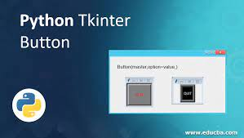
Methodology
Designing Of User Interface
Using Of Python library tkinter.
Having Text-Boxes for uploading the link of videos.
Result will be displayed after backend process.

Slide 12

2. Backend Process:
Data Extraction
Library Required:
Speech Recognition
For connection with Google Speech API.
MoviePy
For reading the various video formats.

Slide 13

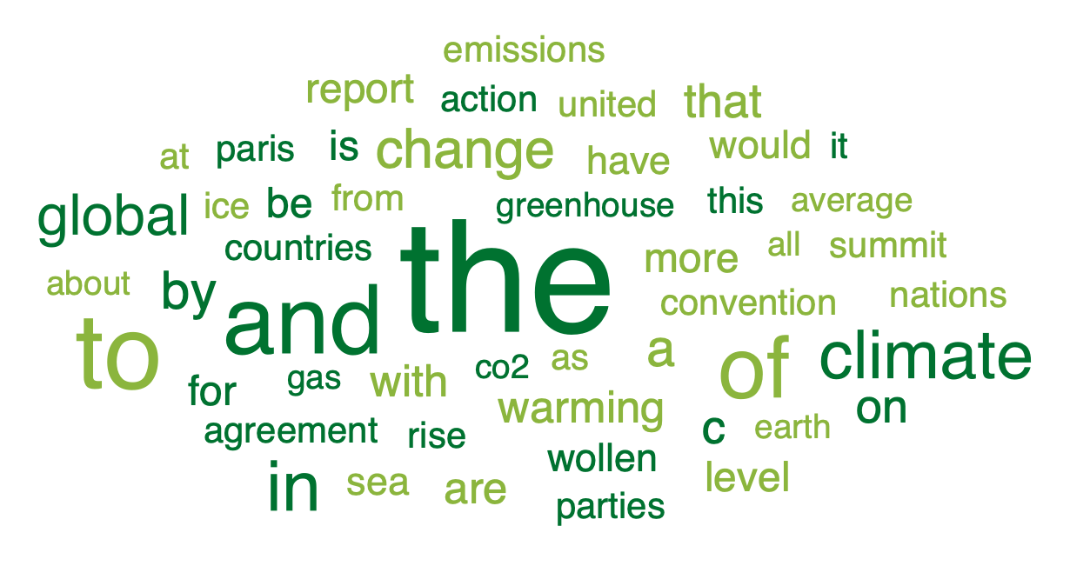
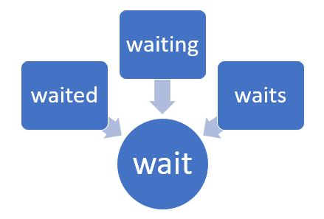
II.Data Cleaning:
Removing Of Punctuation Marks and Special Characters like :- (),&,*
Removing Of Stopwords
Module Used:nltk_corpus
Stemming And Lemmatization
Module Used:nltk_stem

Slide 14

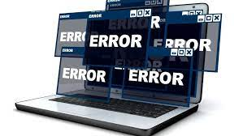
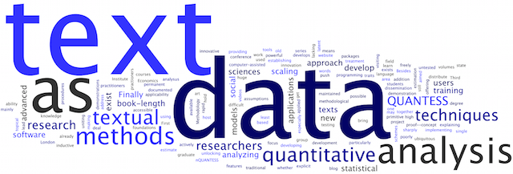
As textual data are not understandable by the computer that’s why Data Preprocessing is performed.
III. Data Preprocessing:

Slide 15
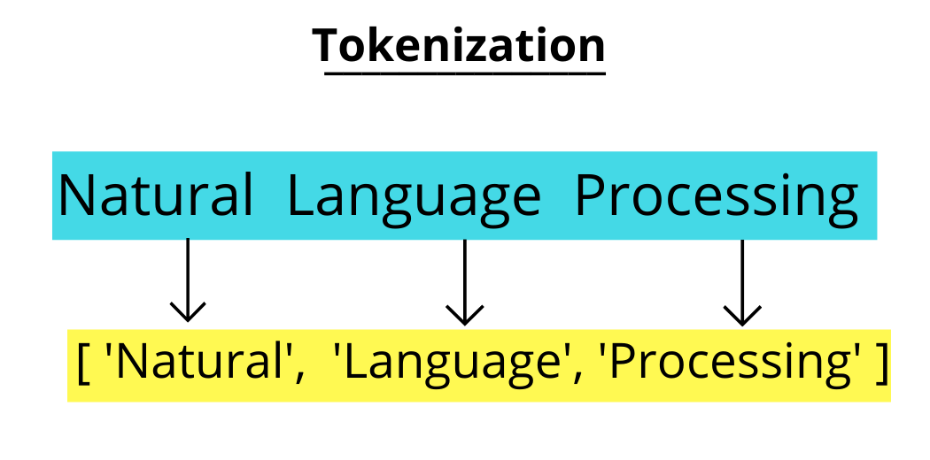
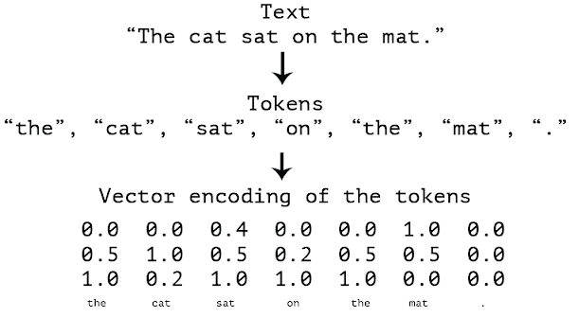
III. Data Preprocessing:
Tokenization of Data:
Vectorization of Tokens:
This is the process of converting text data into words.
Library Required: word_tokenize
Converting the Tokens into unique integers
Library Required: Tokenizer

Slide 16
IV. Creating Model:
Stacked Long Short Term Memory(LSTM) layer will be used for creating the model
LSTM will capture the contextual information present into the input sequence and will return the hidden states output.

Slide 17
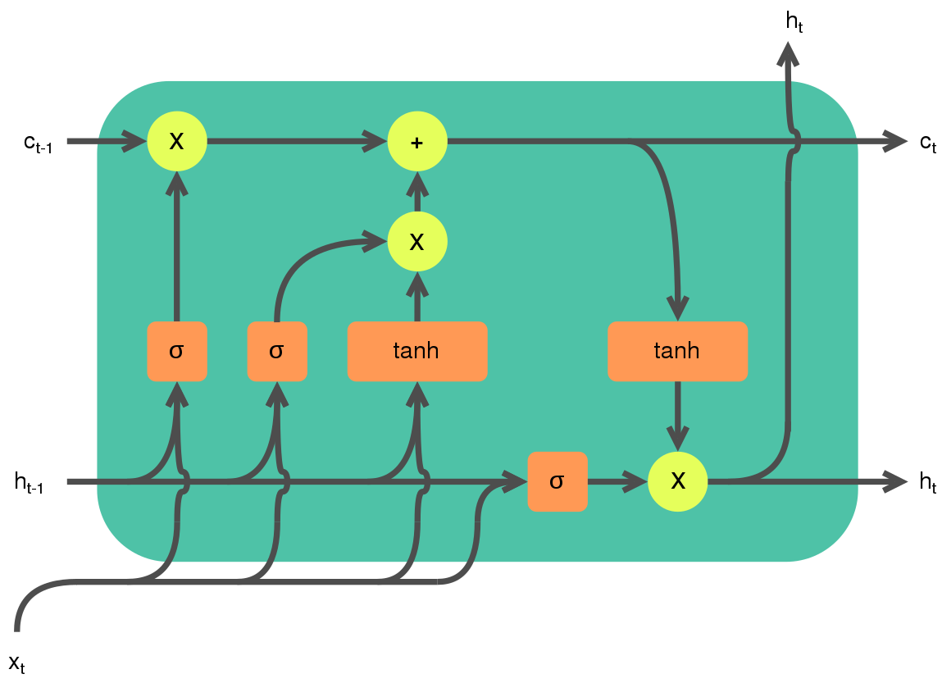
LSTM working:

Slide 18
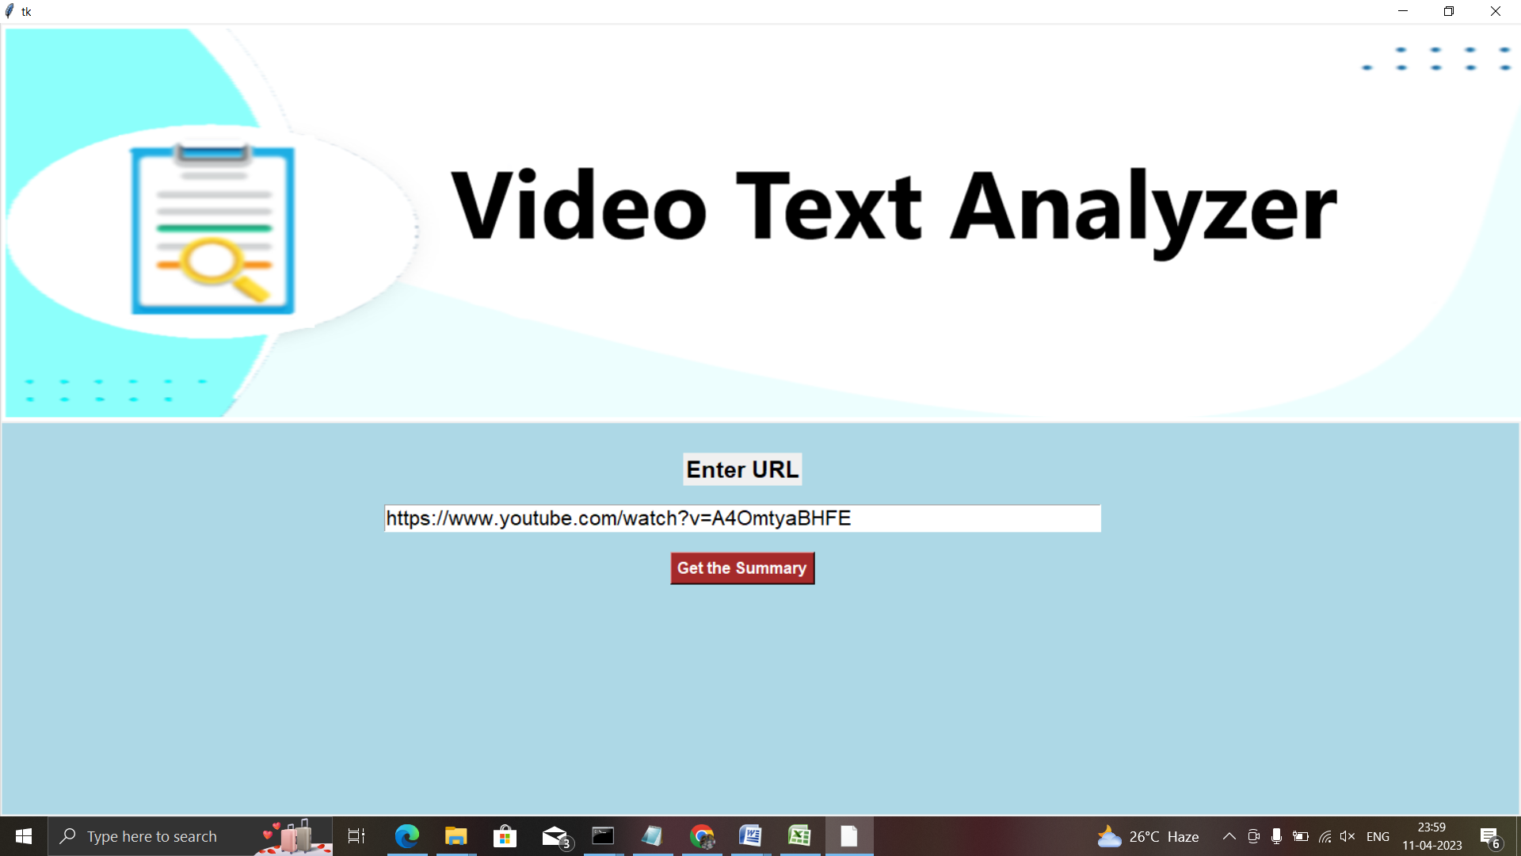
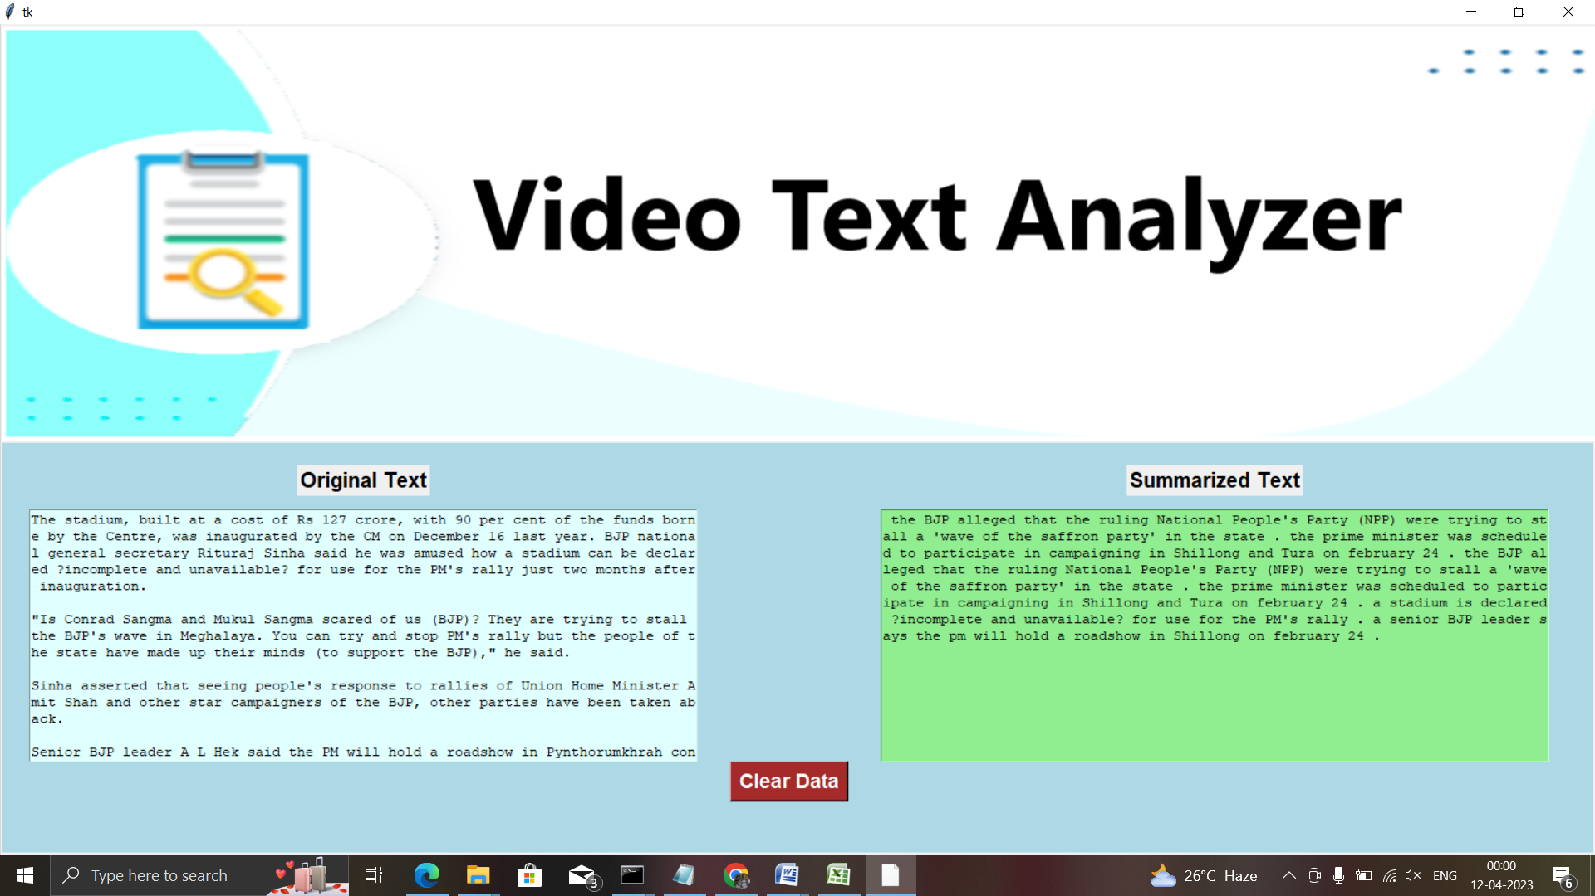
Result

Slide 19
LIBRARY USED
Keras- Text Classification, Video Captioning
NLTK- Text Preprocessing
MoviePy- Video Preprocessing
LancasterStemmer- The LancasterStemmer library is a Python library that provides a stemming algorithm to reduce words to their base or root form
Speech recognition- The speech_recognition library in Python can be used to integrate speech recognition capabilities into an optimized video text analyzer
Tkinter-The tkinter library in Python can be used to create a graphical user interface (GUI) for an optimized video text analyzer

Slide 20
REQUIREMENT ANALYSIS
Hardware Requirements:
OS : Windows 8 or above
Architecture : 32- or 64-bit operating system x64 i.e 86 bit, x32 i.e 86 bit
Minimum 4GB RAM
Minimum 5GB of disk space to install Anaconda

Slide 21
REQUIREMENT ANALYSIS
Network requirements:
Internet Connection with 500+kbps
BandWidth :3-5Mbps

Slide 22
REQUIREMENT ANALYSIS
Software Requirements:
Anaconda Version 2.1 or Latest Version of Anaconda
Jupyter Notebook
Python 3.5 or above
Latest Version of HTML and CSS installed over machine
Browser: Chrome or Internet Explorer.

Slide 23
FUTURE SCOPE
Following are few potential scopes for an optimized video text analyzer.
Improvement of Accuracy
Real-time Video Text Analysis
Multi-lingual Support
Integration with Other Video Analysis Techniques
Deployment in Practical Applications

Slide 24
Thank You

